Slide 1
Huffman Coding

Slide 2
Issues with ASCII Coding
In ASCII, every character is encoded with the same number of bits: 8 bits per character.
Since there are 256 different values that can be encoded with the combination of 8 bits, there are potentially 256 different characters in the ASCII character set -- note that 2⁸ = 256.
The common characters, e.g., alphanumeric characters, punctuation, control characters, etc., use only 7 bits; there are 128 different characters that can be encoded with 7 bits.

Slide 3
A Simple Coding Example
Let’s see how the string "go go gophers" is encoded in ASCII.
Char | ASCII | Binary
g | 103 | 01100111
o | 111 | 01101111
p | 112 | 01110000
h | 104 | 01101000
e | 101 | 01100101
r | 114 | 01110010
s | 115 | 01110011
space | 32 | 01000000

Slide 4
Issues with ASCII Coding
With an ASCII encoding (8 bits per character) the 13 character string "go go gophers" requires 104 bits.
The string "go go gophers" would be written (coded numerically) as 103 111 32 103 111 32 103 111 112 104 101 114 115.
Although not easily readable by humans, this would be written as the following stream of bits (the spaces would not be written, just the 0's and 1's)
01100111 01101111 01000000 01100111 01101111 01000000 01100111 01101111 01110000 01101000 01100101 01110010 01110011

Slide 5
3-Bit Encoding
Since there are only eight different characters in "go go gophers", it's possible to use only 3 bits to encode the different characters. We might, for example, use the encoding in the table given below, though other 3-bit encodings are possible.
Char | Code | Binary
g | 0 | 000
o | 1 | 001
p | 2 | 010
h | 3 | 011
e | 4 | 100
r | 5 | 101
s | 6 | 110
space | 7 | 111

Slide 6
3-Bit Encoding
Now the string "go go gophers" would be encoded as
0 1 7 0 1 7 0 1 2 3 4 5 6 or,
as bits:
000 001 111 000 001 111 000 001 010 011 100 101 110 111

Slide 7
3-Bit Encoding
By using three bits per character, the string "go go gophers" uses a total of 39 bits instead of 104 bits.
More bits can be saved if we use fewer than three bits to encode characters like g, o, and space that occur frequently and more than three bits to encode characters like e, p, h, r, and s that occur less frequently in "go go gophers".
This is the basic idea behind Huffman coding: to use fewer bits for more frequently occurring characters.

Slide 8
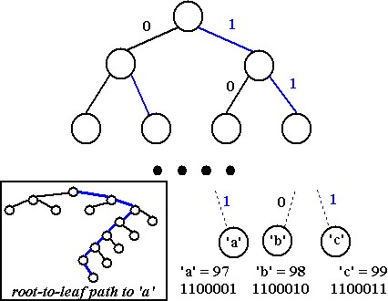
Coding Tree

Slide 9
Coding Tree
Using a tree, all characters are stored at the leaves of a complete tree. In the above diagram, the tree has eight levels meaning that the root-to-leaf path always has seven edges.
A left-edge (black in the diagram) is numbered 0, a right-edge (blue in the diagram) is numbered 1.
The ASCII code for any character/leaf is obtained by following the root-to-leaf path and concatenating the 0's and 1's.
For example, the character 'a', which has ASCII value 97 (1100001 in binary), is shown with root-to-leaf path of right-right-left-left-left-left-right.

Slide 10
Huffman Coding
Huffman coding is a lossless data compression algorithm.
The most frequent character gets the smallest code and the least frequent character gets the largest code.
The variable-length codes assigned to input characters are Prefix Codes, means the codes (bit sequences) are assigned in such a way that the code assigned to one character is not prefix of code assigned to any other character.
This is how Huffman Coding makes sure that there is no ambiguity when decoding the generated bit stream.

Slide 11
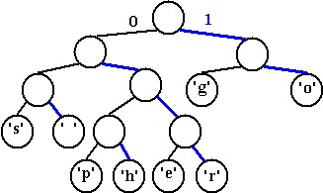
Coding Tree
The structure of the tree can be used to determine the coding of any leaf by using the 0/1 edge convention described. If we use a different tree, we get a different coding. As an example, the tree below on the right yields the coding shown on the left.
Char | Binary
g | 10
o | 11
p | 0100
h | 0101
e | 0110
r | 0111
s | 000
space | 001

Slide 12
Coding Tree
Using this coding, "go go gophers" is encoded (spaces wouldn't appear in the bitstream) as:
10 11 001 10 11 001 10 11 0100 0101 0110 0111 000
This is a total of 37 bits, which saves two bits from the encoding in which each of the 8 characters has a 3-bit encoding that was shown in slide no. 5! The bits are saved by coding frequently occurring characters like 'g' and 'o' with fewer bits (here two bits) than characters that occur less frequently like 'p', 'h', 'e', and 'r'.

Slide 13
Coding Tree
The character-encoding induced by the tree can be used to decode a stream of bits as well as encode a string into a stream of bits. You can try to decode the following bitstream;
01010110011100100001000101011001110110001101101100000010101 011001110110
To decode the stream, start at the root of the encoding tree, and follow a left-branch for a 0, a right branch for a 1.
When you reach a leaf, write the character stored at the leaf, and start again at the top of the tree.

Slide 14
Prefix Codes
When all characters are stored in leaves, and every interior/(non-leaf) node has two children, the coding induced by the 0/1 convention outlined above has what is called the prefix property: no bit-sequence encoding of a character is the prefix of any other bit-sequence encoding.

Slide 15
Prefix Codes
This makes it possible to decode a bitstream using the coding tree by following root-to-leaf paths.
The tree shown above for "go go gophers" is an optimal tree: there are no other trees with the same characters that use fewer bits to encode the string "go go gophers".
There are other trees that use 37 bits; for example you can simply swap any sibling nodes and get a different encoding that uses the same number of bits.
We need an algorithm for constructing an optimal tree which in turn yields a minimal per-character encoding/compression.
This algorithm is called Huffman coding, and was invented by D. Huffman in 1952. It is an example of a greedy algorithm.

Slide 16
Algorithm: Huffman Coding
There are mainly two major parts in Huffman Coding
1) Build a Huffman Tree from input characters.
2) Traverse the Huffman Tree and assign codes to characters.

Slide 17
Algorithm: Huffman Coding
Steps to build Huffman Tree
Input: An array of unique characters along with their frequency of occurrences
Output: Huffman Tree.
1. Begin with a forest of trees. All trees are one node, with the weight of the tree equal to the weight of the character in the node. Characters that occur most frequently have the highest weights. Characters that occur least frequently have the smallest weights.
2. Repeat this step until there is only one tree:
Choose two trees with the smallest weights, call these trees T₁ and T₂. Create a new tree whose root has a weight equal to the sum of the weights T₁ + T₂ and whose left subtree is T₁ and whose right subtree is T₂.
3. The single tree left after the previous step is an optimal encoding tree.

Slide 18

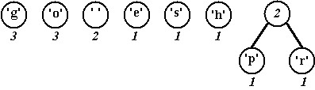
Algorithm: Huffman Coding
We'll use the string "go go gophers" as an example. Initially we have the forest shown below. The nodes are shown with a weight/count that represents the number of times the node's character occurs.

Slide 19
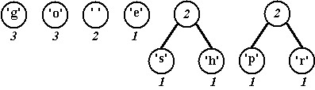
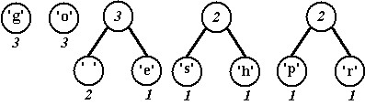
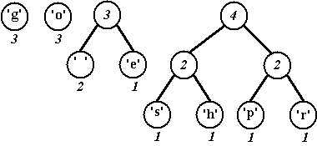
Algorithm: Huffman Coding

Slide 20
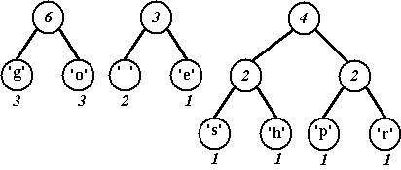
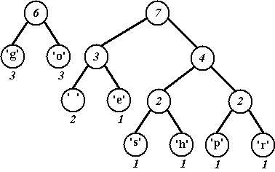
Algorithm: Huffman Coding

Slide 21
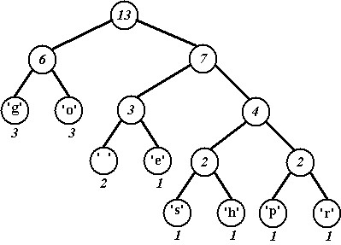
Algorithm: Huffman Coding

Slide 22
Algorithm: Huffman Coding
The character encoding induced by the last tree is shown below where again, 0 is used for left edges and 1 for right edges.
Char | Binary
g | 00
o | 01
p | 1110
h | 1101
e | 101
r | 1111
s | 1100
space | 100

